Slide 1
PRESENTATION

Slide 2
Problem Statement
The rapid growth of digital technologies has significantly increased the vulnerability of individuals, businesses, and governments to cyber threats, ranging from data breaches to advanced persistent attacks. This creates an urgent need for robust cybersecurity measures, effective threat detection, and proactive solutions to safeguard critical information and ensure digital resilience in the modern age.

Slide 3
INTRODUCTION
As technology advances, cyber threats like malware, ransomware, and phishing are becoming more common and sophisticated, putting individuals, businesses, and governments at risk. This project explores these emerging cyber threats, the vulnerabilities in digital systems, and the effectiveness of current cybersecurity solutions such as encryption and firewalls. It aims to offer practical insights into improving digital security and protecting data and privacy in today’s interconnected world.

Slide 4
PURPOSE
The purpose of this project is to understand cybersecurity threats and find ways to protect against them. In today’s digital world, cyber threats like malware, phishing, and ransomware are becoming more common and dangerous. These attacks can steal personal information, damage systems, and cause financial loss.
this project is about identifying cybersecurity issues, learning how to fix them, and helping others understand how to stay protected in an increasingly connected world..

Slide 5
OBJECTIVE
1. Identify Cyber Threats – Analyse various cyber risks such as malware, phishing, and ransomware
2. Explore Security Solutions – Study encryption, firewalls, multi-factor authentication, and other protective measures.
3. Promote Cyber Awareness – Educate individuals and organizations on best practices for digital safety.
4. Assess Emerging Technologies – Examine the role of AI, blockchain, and other innovations in cybersecurity.

Slide 6
SCOPE
The project identifies common cyber threats, analyzes security solutions, and examines emerging technologies such as AI and blockchain in security. It provides strategies for individuals and organizations to reduce risks and includes real-world case studies to strengthen digital security.

Slide 7
REQUIREMENT
○ 8 GB RAM
○ i3 intel core
○ 256GB SSD

Slide 8
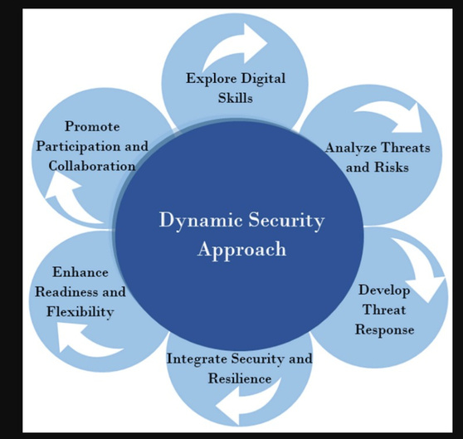
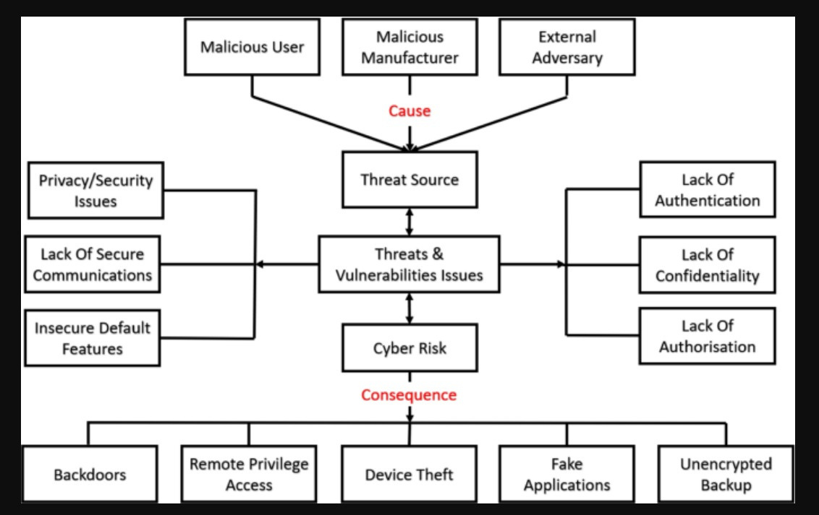
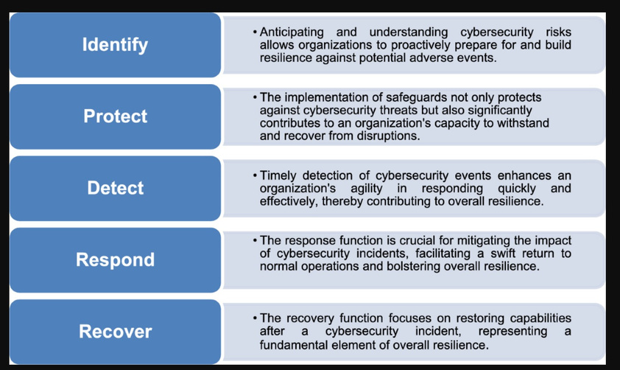
DESIGN
PROBLEM SOLUTION FIT
PROPOSED SOLUTION
SOLUTION ARCHITECTURE

Slide 9
CONCLUSION
This project, "Exploring Cyber Security: This project studied cybersecurity threats and solutions using tools like Nessus and SOC monitoring. It highlighted the importance of:
Understanding Cyber Threats & Security Measures
Vulnerability Assessment & Nessus Findings
SOC & SIEM Security Monitoring Analysis

Slide 10
THANK YOU

